Slide 1
Transaction Processing- II

Slide 2
Scheduling of Transactions
Serializable Schedule: A non-serial schedule that is equivalent to some serial execution of transactions is called a serializable schedule.
The objective of serializability is to find non-serial schedules that allow transactions to execute concurrently without interfering with one another, and thereby produce a database state that could be produced by a serial execution.

Slide 3
Serializability
Basic Assumption – Each transaction preserves database consistency.
Thus serial execution of a set of transactions preserves database consistency.
A (possibly concurrent) schedule is serializable if it is equivalent to a serial schedule. Different forms of schedule equivalence give rise to the notions of:
1. conflict serializability
2. view serializability

Slide 4
Conflict Serializability
If a schedule S can be transformed into a schedule S’ by a series of swaps of non-conflicting instructions, we say that S and S’ are conflict equivalent.
We say that a schedule S is conflict serializable if it is conflict equivalent to a serial schedule.

Slide 5
Conflict Serializability
We need to check the conflicts between two consecutive operations of two different transactions in a schedule. Operations upon data can be read or write. There are two possibilities:
If two consecutive operations are on different data items, then they do not conflict i.e., their order of execution does not matter and we can swap them without affecting their result.
If two consecutive operations are on same data items, then they can conflict i.e. their order of execution matters and we cannot swap them.

Slide 6
Conflict Serializability
Consider a schedule S in which there are two consecutive operations Oi and Oj of two transactions Ti and Tj and both operations refer to the same data item A. Then, there are following four cases:
Oi= read(A) and Oj= read(A). Then, their order does not matter because same value of A is read by Ti and Tj.
Oi= read(A) and Oj= write(A). Then, their order matters. If Oi comes before Oj then, Oj does not read the value of A written by Oi. If Oj comes before Oi then, Oi reads the value of A that is written by Oj.
Oi= write(A) and Oj= read(A). Then, their order matters. If Oi comes before Oj then, Oj reads the value of A written by Oi. If Oj comes before Oi then, Oj does not read the value of A that is written by Oi.
Oi= write(A) and Oj= write(A). Then, their order matters. If Oi comes after Oj then, the value of A written by Oi is stored in database. If Oj comes after Oi then, the value of A written by Oj is stored in database.

Slide 7
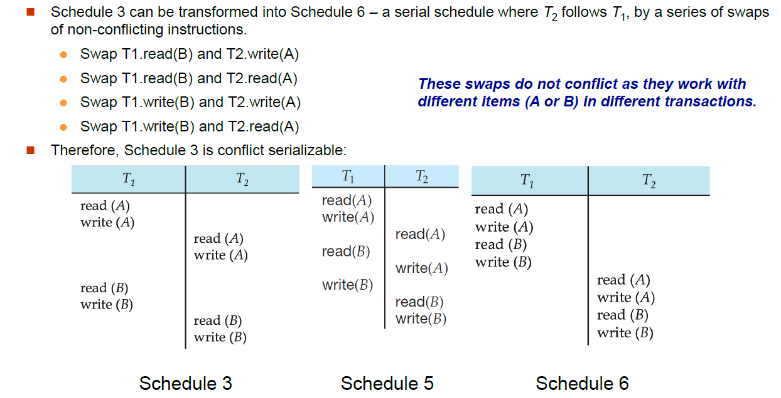
Conflict Serializability

Slide 8
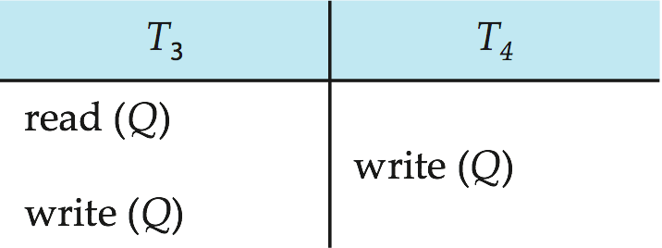
Conflict Serializability (Cont.)
Example of a schedule that is not conflict serializable:
We are unable to swap instructions in the above schedule to obtain either the serial schedule < T₃, T₄ >, or the serial schedule < T₄, T₃ >.

Slide 9
Question
Consider the following schedule for a set of three transactions.
w1(A),w2(A),w2(B),w1(B),w3(B)
Find whether the schedule is conflict serializable or not?

Slide 10
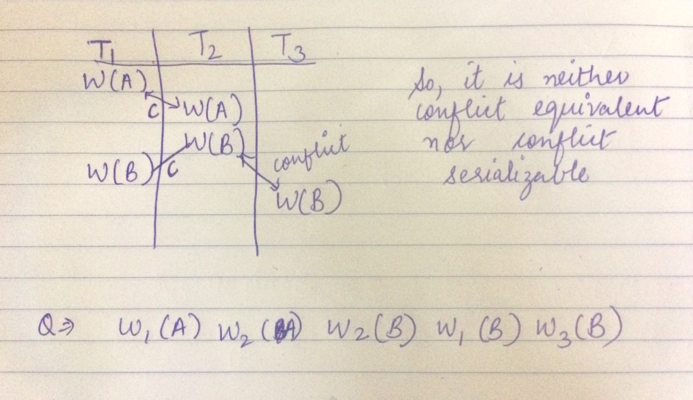

Slide 11
Question
ScheduleU:
r2(A),w2(A),r1(A),w1(A),r2(B),w2(B)
Check whether the given schedule is conflict serializable?

Slide 12
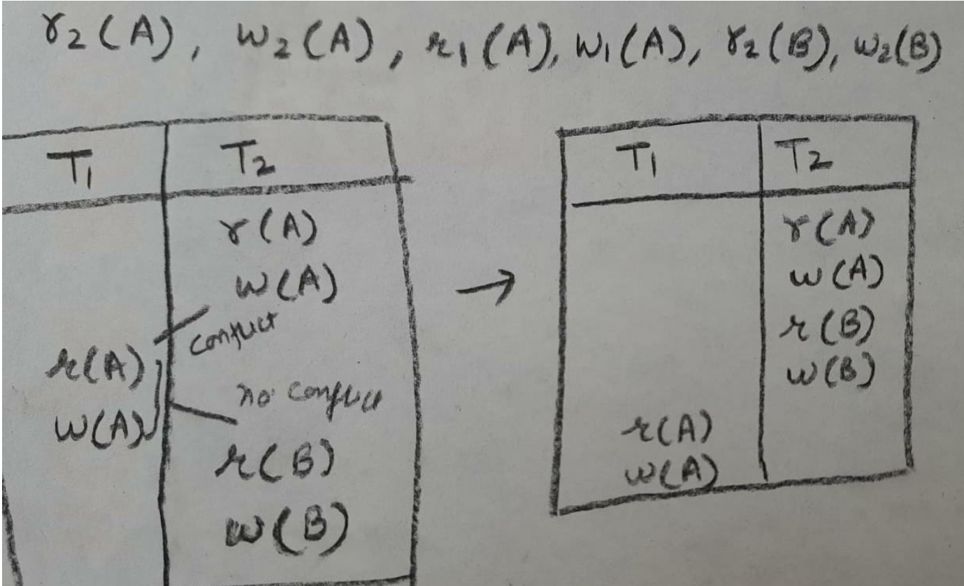

Slide 13
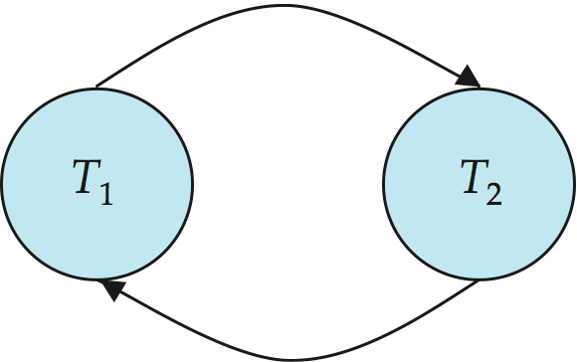
Precedence Graph
Consider some schedule of a set of transactions T₁, T₂, ..., T_{n}
Precedence graph — a direct graph where the vertices are the transactions (names).
We draw an arc from T_{i} to T_{j} if the two transaction conflict, and T_{i} accessed the data item on which the conflict arose earlier.
We may label the arc by the item that was accessed.
Example

Slide 14
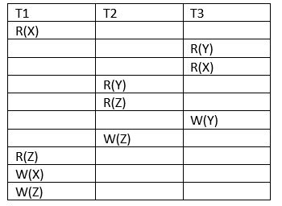
Check the conflict pairs in other transaction and draw edges

Slide 15
Check the conflict pairs in other transaction and draw edges
T1
T2
T3

Slide 16
Conflict Serializability
If no loop or cycle found then schedule is conflict serializable.
serializable
Consistent (no conflicts)
Now, for the S schedule there are 6 possibilities
T1 -> T2 -> T3 to find the conflict equivalent schedule from these
T1 -> T3 - > T2 possibilities we need to check indegree
T2 -> T1 -> T3 of precedence graph
T2 -> T3 -> T1
T3 ->T1 -> T2
T3 -> T2 -> T1

Slide 17
Conflict Serializability
Vertex T2 is having 0 indegree, So REMOVE THIS
T1
t3 NOW, vertex t3 is having 0 indegree , So remove this
So THE ORDER OF transactions will be
T2 -> t3 -> t1 this will be the conflict serializable schedule of the given schedule S.
T1 t2
t3

Slide 18
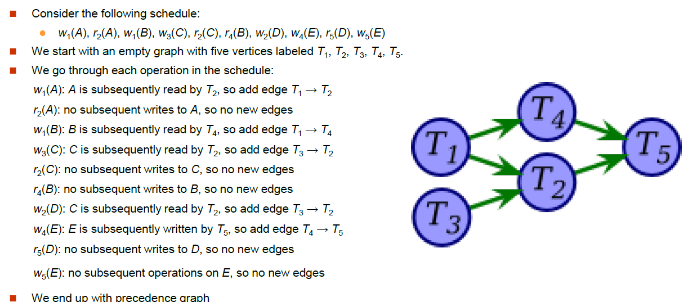
Notes:
This graph has no cycles, so the original schedule must be serializable.

Slide 19
Question
Schedule S:
r1(A),w2(A),w1(A),w3(A)
Check whether the given schedule is conflict serializable?
Yes, it is conflict serializable
No, it is not conflict serializable

Slide 20
View Serializability
A schedule will view serializable if it is view equivalent to a serial schedule.
If a schedule is conflict serializable, then it will be view serializable.
The view serializable which does not conflict serializable contains blind writes.

Slide 21
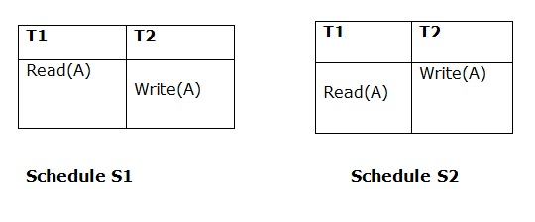
View Equivalent
Two schedules S1 and S2 are said to be view equivalent if they satisfy the following conditions:
1. Initial Read
An initial read of both schedules must be the same. Suppose two schedule S1 and S2. In schedule S1, if a transaction T1 is reading the data item A, then in S2, transaction T1 should also read A.
Above two schedules are view equivalent because Initial read operation in S1 is done by T1 and in S2 it is also done by T1.

Slide 22
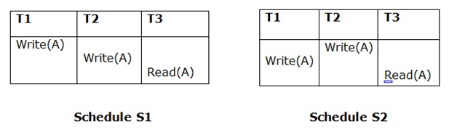
Updated Read
In schedule S1, if Ti is reading A which is updated by Tj then in S2 also, Ti should read A which is updated by Tj.
Above two schedules are not view equal because, in S1, T3 is reading A updated by T2 and in S2, T3 is reading A updated by T1.

Slide 23
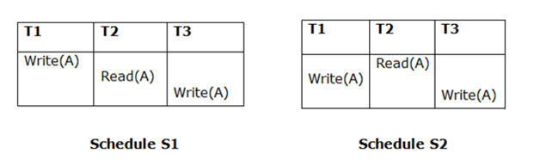
Final Write
A final write must be the same between both the schedules. In schedule S1, if a transaction T1 updates A at last then in S2, final writes operations should also be done by T1.
Above two schedules is view equal because Final write operation in S1 is done by T3 and in S2, the final write operation is also done by T3.

Slide 24
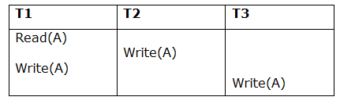
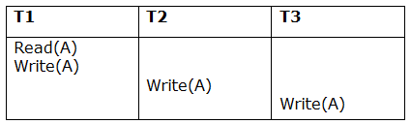
Schedule S
Schedule S1

Slide 25
Taking first schedule S1:
Schedule S1
Step 1: final updation on data items
In both schedules S and S1, there is no read except the initial read that's why we don't need to check that condition.
Step 2: Initial Read
The initial read operation in S is done by T1 and in S1, it is also done by T1.
Step 3: Final Write
The final write operation in S is done by T3 and in S1, it is also done by T3. So, S and S1 are view Equivalent.

Slide 26
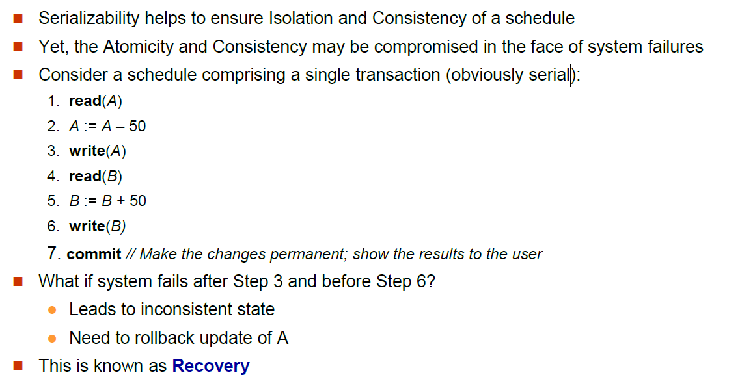
What is recovery?

Slide 27
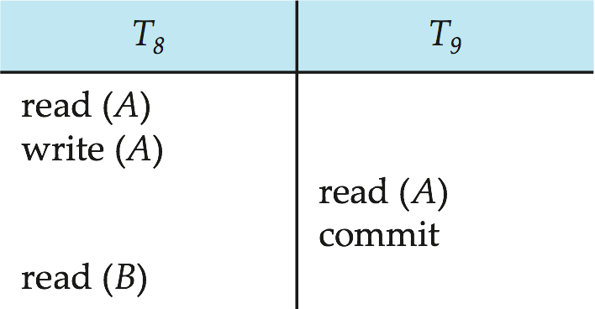
Recoverable Schedules
Recoverable schedule — if a transaction T_{j} reads a data item previously written by a transaction T_{i} , then the commit operation of T_{i} must appear before the commit operation of T_{j}.
The following schedule is not recoverable if T₉ commits immediately after the read(A) operation.
If T₈ should abort, T₉ would have read (and possibly shown to the user) an inconsistent database state. Hence, database must ensure that schedules are recoverable.

Slide 28
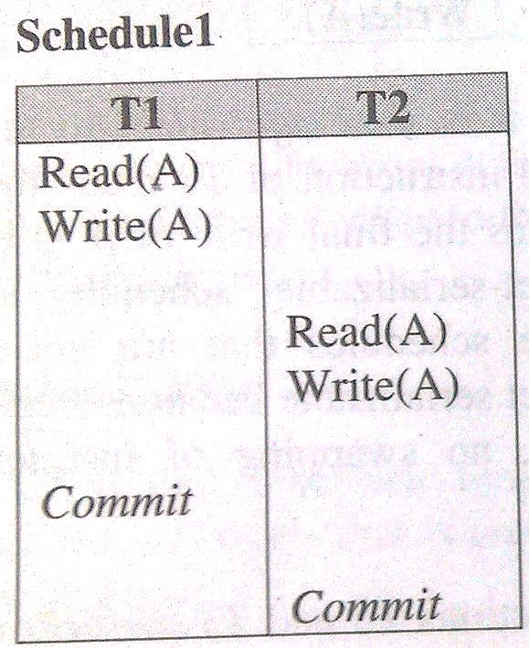
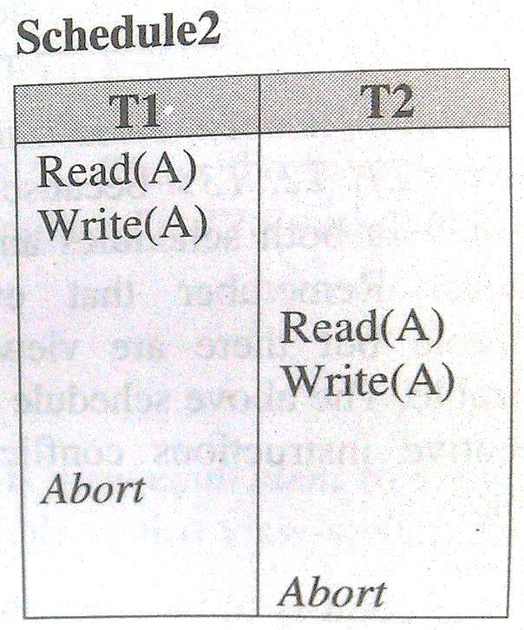
Recoverable Schedules
A schedule is said to be recoverable, if for each pair of transaction Ti and Tj such that Tj reads a data item previously written by Ti, the commit operation of Ti appears before the commit operation of Tj.
Both the above schedules are recoverable .

Slide 29
Recoverable Schedules
Schedule1 is recoverable because T2 reads the value of A updated by T1 and also T1 commits before T2 which makes the value read by T2 correct. Then T2 can commit itself.
In schedule2, if T1 is aborted, T2 has to abort because the value A it read is incorrect.
In both cases, the database is in consistent state.

Slide 30
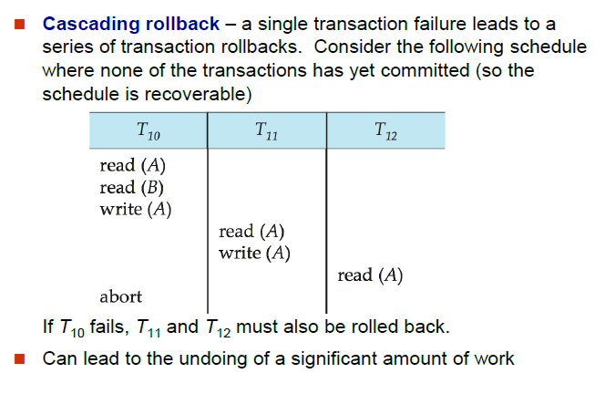
Cascading Rollbacks

Slide 31
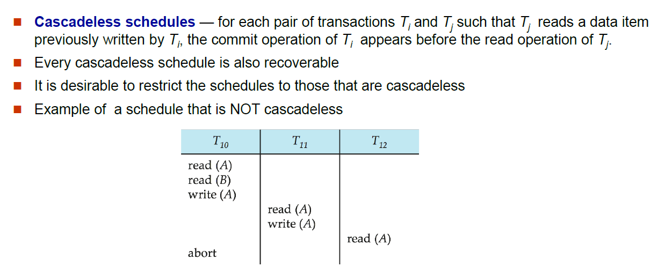
Cascadeless Schedules

Slide 32
Failure Classification
To find that where the problem has occurred, we generalize a failure into the following categories:
Transaction failure
System crash
Disk failure

Slide 33
1. Transaction failure
The transaction failure occurs when it fails to execute or when it reaches a point from where it can't go any further. If a few transaction or process is hurt, then this is called as transaction failure.
Reasons for a transaction failure could be -
Logical errors: If a transaction cannot complete due to some code error or an internal error condition, then the logical error occurs.
Syntax error: It occurs where the DBMS itself terminates an active transaction because the database system is not able to execute it. For example, The system aborts an active transaction, in case of deadlock or resource unavailability

Slide 34
2. System Crash
System failure can occur due to power failure or other hardware or software failure. Example: Operating system error.
Fail-stop assumption: In the system crash, non-volatile storage is assumed not to be corrupted.

Slide 35
3. Disk Failure
It occurs where hard-disk drives or storage drives used to fail frequently. It was a common problem in the early days of technology evolution.
Disk failure occurs due to the formation of bad sectors, disk head crash, and unreachability to the disk or any other failure, which destroy all or part of disk storage.

Slide 36
Concurrency Control
A database must provide a mechanism that will ensure that all possible schedules are both:
Conflict serializable.
Recoverable and preferably cascadeless
A policy in which only one transaction can execute at a time generates serial schedules, but provides a poor degree of concurrency
Concurrency-control schemes tradeoff between the amount of concurrency they allow and the amount of overhead that they incur
Testing a schedule for serializability after it has executed is a little too late!
Tests for serializability help us understand why a concurrency control protocol is correct
Goal – to develop concurrency control protocols that will assure serializability.

